Slide 1
Retirement Benefits
Updated 5-28-2025

Slide 2
Agenda
NEXCOM Benefit Package
Retirement Income Sources
Retirement Plan
401(k) Plan
Social Security/Medicare
Post Retirement Medical/Dental/Life
Will Preparation

Slide 3
NEXCOM Benefit Package
Pension Plan: By far, the pension retirement plan is the richest benefit NEXCOM offers. Today, only about 7% of companies offer this form of retirement benefit.
401(k) Plan: You can contribute up to 6% of your basic earnings and receive a company match of $.50/$1.00. That’s like getting a 50% return on your money. Example: You put
$100 into the 401(k). NEXCOM puts in $50.
Health Plans: You have a choice of an Aetna regular traditional health plan or an Aetna High Deductible Health Plan. Vision Care is included in the Aetna Plans. Our Aetna regular traditional health plan has some of the lowest deductibles in the nation-- $500 for “Associate only” coverage and $1,500 for “Family” coverage. Depending on where you live, you may also have a choice of a Health Maintenance Organization (HMO).
Dental Plans: If you enroll in a medical plan, you can enroll in our very low cost dental plan. How does $4.50/pay period grab you? If you don’t elect medical, you can choose our Stand Alone Dental Plan.
Life Insurance Plans: Depending on your category of employment, you can apply for Basic and/or Optional Life Insurance. If you are enrolled in Basic life insurance, you may also buy Dependent Life Insurance for pennies on the dollar. Another feature that sets us apart from other companies . . . you get a whole suite of End-of-Life planning services. This includes such services as free will preparation for you and your spouse, medical directives, a medical power of attorney, and a digital storage app to keep all things important (documents, videos, photos, passwords, etc.).
Short-Term Disability & Long Term Disability (LTD) Plans: These insurance plans help keep money flowing when you are sick or injured for an extended period of time.

Slide 4
Retirement Income Sources

Slide 5
NEXCOM Retirement Plan
HIGHLIGHTS OF YOUR RETIREMENT PLAN
As of August 1, 2015, newly hired associates will be automatically enrolled in the Plan.
You will not be required to contribute to the Plan during your first year of employment and you will receive one year of credited service.
Thereafter, you contribute only 1% of your pay through payroll deduction - NEXCOM pays the balance needed to provide your Plan benefits.
You are fully vested in the Plan after completing 5 years of continuous regular full time or part time service.
You are eligible to retire with a normal retirement benefit on the first of the month that falls on or after your 62nd birthday, or with the completion of 5 years of continuous service, whichever is later.
You may elect to retire later than your normal retirement date.

Slide 6
NEXCOM Early Retirement
You may retire early with full retirement benefits if you have reached your 55th birthday and have completed at least 30 years of continuous service or if you have reached your 60th birthday and have completed at least 20 years of continuous service.
You may retire early with a reduced retirement benefit if you have reached your 52nd birthday and have completed at least 5 years of continuous service subject to certain conditions.
If you leave your employment before retirement, you will always be entitled to the return of your contributions with interest.
Interest is credited for periods after March 1, 1968, at the rate of 3% compounded annually.
If you leave after completing at least five years of continuous service, you may leave your contributions in the Plan and receive a deferred vested benefit as early as age 52.

Slide 7
Credited Service
CREDITED SERVICE
Your “credited service” is an important factor in calculating your retirement income. Credited service in the Plan includes the number of years and months during which you made contributions to the Plan. If you did not enroll on a timely basis, that period of service will not be included as “Credited Service.”
In addition, your credited service also includes certain periods for which you were not required to make contributions, such as:
Unused sick leave, which is your accumulated hours of unused sick leave at the date of retirement, converted to an equivalent period of credited service. For purposes of conversion, 173 hours of unused sick leave is equivalent to one month’s service.
Unused sick leave is only used in counting the number of years and months of credited service for benefit calculation purposes. It is not used to meet continuous service or age requirements for retirement eligibility purposes.

Slide 8
NEXCOM Retirement Plan
Pension Plan (Final average pay formula)
Associates contribute 1% of pay (No contribution during 1st year of service)
Vested after 5 years
COLA adjustment for eligible associates
Very rich plan uncommon in private industry

Slide 9
NEXCOM Retirement Plan
Retirement Formula
The average of the highest 36 consecutive months of earnings during which you made contributions to the Plan (times your years of credited service).
Social Security Offset applies at Age 62 or later depending upon your age at retirement.
With 35 years of service and retiring at Age 62, we estimate an annual benefit equal to 50% of your final earnings.

Slide 10
NEXCOM Retirement Plan
Estimated Retirement Benefit @ Age 62
Highest 36 months of earnings Years of Credited Service
Social Security Benefit @ Age 62
= $50,000
= 35
=$15,552
First 5 years of credited service = 1.50% X $50,000 X 5
= $ 3,750
= $ 4,375
= $25,000
$33,125
- ($ 8,165)
Next 5 years of credited service = 1.75% X $50,000 X 5 Next 25 years of credited service = 2.00% X $50,000 X 25 Annual Benefit
Social Security Offset 1.50% X $15,552 X 35
NET RETIREMENT BENEFIT= $24,960 PER YEAR
Log onto LEARN (Note: user name is your payroll number) to use the Pension Estimate Generator.

Slide 11
Retirement Plan – Forms of Retirement
Type | Eligibility | Annual Cost of Living Adjustment | Reduced Benefit
1. Normal | Age 62 w/ 5 years continuous service | Yes | No
2. Voluntary Early | Age 55 w/ 30 years continuous service Age 60 w/ 20 years continuous service | Yes | No
3. Optional Early | Age 52 w/ 5 years continuous service | Yes | Yes
4. Optional Later | After age 62 w/ 5 years continuous service | Yes | No
11

Slide 12
Accessing Your 401(k) Plan Funds
Options after termination of employment or retirement:
Leave money in the plan if over $7,000
401(k) Plan is efficient investment vehicle
Rollover to a traditional IRA or another 401(k) plan
No tax penalty for direct rollover
Lump sum or installment distributions
Required Minimum Distribution (RMD) at 73
12

Slide 13
Social Security
HOW TO YOU QUALIFY FOR SOCIAL SECURITY RETIREMENT BENEFITS?
By earning “credits” when you work and pay Social Security taxes
You need 40 credits (10 years of work) and you must be 62 or older
In 2025, Each $1,810 in earnings gives you one credit.
You can earn a maximum of four credits per year. In 2025, this would equate to $7,240 in earnings.
13

Slide 14
Social Security

Slide 15
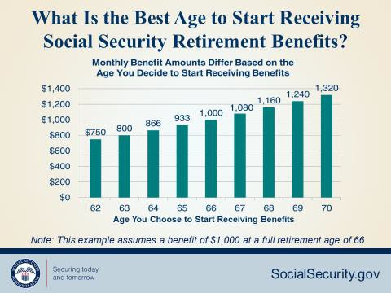
Social Security
15

Slide 16
Social Security
Year of Birth | Full Retirement Age | A $1000 retirement benefit taken at age 62 would be reduced by | A $500 spouse benefit taken at age 62 would be reduced by
1943-1954 | 66 | 25% | 30%
1955 | 66 and 2 months | 25.83% | 30.83%
1956 | 66 and 4 months | 26.67% | 31.67%
1957 | 66 and 6 months | 27.5% | 32.5%
1958 | 66 and 8 months | 28.33% | 33.33%
1959 | 66 and 10 months | 29.17% | 34.17%
1960 + | 67 | 30% | 35%

Slide 17
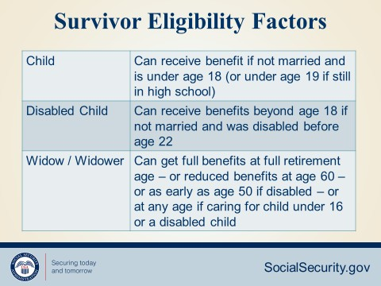
Social Security

Slide 18
Social Security
18

Slide 19
Medicare
19

Slide 20
Medicare
20

Slide 21
Medicare
21

Slide 22
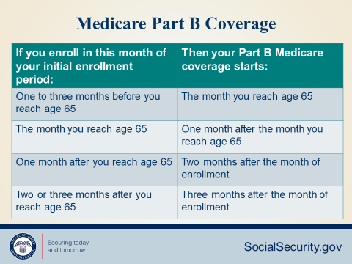
Medicare
22

Slide 23
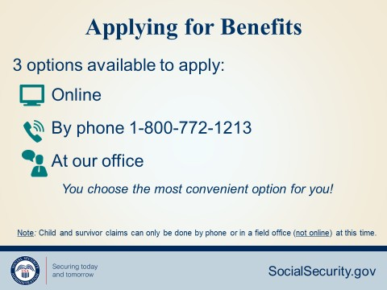
Social Security/Medicare
23

Slide 24
Post Retirement Benefits
Medical/Dental Benefits
24

Slide 25
Post-Retirement Medical/Dental Provisions
Associates are eligible to continue participation in the Medical Plan at retirement, and beyond age 65, if they meet the following three conditions:
Enrolled in the Plan on the day before retirement and,
Have 15 years accumulated participation in any combination of DOD NAF Component health plans.
Receive an immediate annuity from the NEXCOM Retirement Plan.
25

Slide 26
Post Retirement Medical Plan
CONUS retirees and family members age 65 and over have one medical plan option if they choose to stay with a DoD NAF medical plan. It's called the Medicare Advantage with Prescription Drug (MAPD) plan.
To be enrolled in this plan, you must be retired, live in the U.S. and be enrolled in Medicare Parts A & B. CONUS retirees must also provide the NEXCOM Benefits Department with Medicare ID numbers for themselves and their eligible dependents.
NEXCOM shares the cost with retirees. Retirees and covered dependents under age 65, as well as retirees living overseas, will remain in their current DoD NAF medical plan. Learn more at nafhealthplans.com > NAF retirees.

Slide 27
Life Insurance
Post Retirement Life Insurance Benefit:
If you are enrolled in Basic Group Life (BGL) and Optional Group Life insurance (OGL) at retirement and have participated for 15 or more years, coverage will be continued at no cost when you retire.
After retirement your BGL coverage will be reduced by 25% at ages 66, 67 and 68. Your OGL coverage will be reduced to 25% of your preretirement benefit.
26

Slide 28
Will Preparation & Estate Planning
If you are participating in the Basic or Optional Life Insurance Plans , you can take advantage of Will Preparation Services and Estate Resolution Services at no cost.
Prepare/Update Wills
Powers of attorney
Lawyer representation for settling your estate
Accessing the services is simple
CONUS contact MetLife Legal Plans at 1-800-821- 6400. Plan #109800
Overseas contact MetLife Legal Plans at 216-535-4395 or email csc@legalplans.com
.

Slide 29
Next Steps
Create your personal my Social Security account today by going to: SSA.gov/myaccount
Use the Retirement Estimate Generator on LEARN (user ID is your payroll number) to model different scenarios
Provide at least 90 days notice of your intent to retire to your supervisor and HR representative

Slide 30
Questions?
Contact your local Human Resources representative or log onto NEXCOM’s Virtual Benefits Fair.
29

